Slide 1
The Self-Organizing Map (SOM)
A neural network approach to unsupervised machine learning.
Appealing visual presentation of learned results as a 2D map.
Learned result represents a partitioning of the input space according to a similarity metric.
T. Kohonen, Self-organizing maps, 3rd ed. Berlin ; New York: Springer, 2001.

Slide 2
SOM Architecture
Source: http://media.springernature.com/full/springer-static/image/art%3A10.1186%2Fs40677-015-0022-9/MediaObjects/40677_2015_22_Fig3_HTML.gif

Slide 3
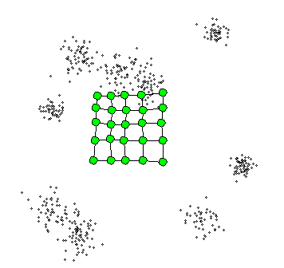
Insight: SOMs Sample the Data Space
Given some distribution in the data space, SOM will try to construct a sample that looks like it was drawn from the same distribution.
It will construct the sample using interpolation (neighborhood function) and constraints (the map grid).
We can then measure the quality of the map using a statistical two sample approach.
Algorithm:
Repeat until Done
For each training observation Do
Find the neuron that best matches the observation.
Make that neuron look more like the observation.
Smooth the immediate neighborhood of that neuron.
End For
End Repeat
Animation source: www.peltarion.com

Slide 4
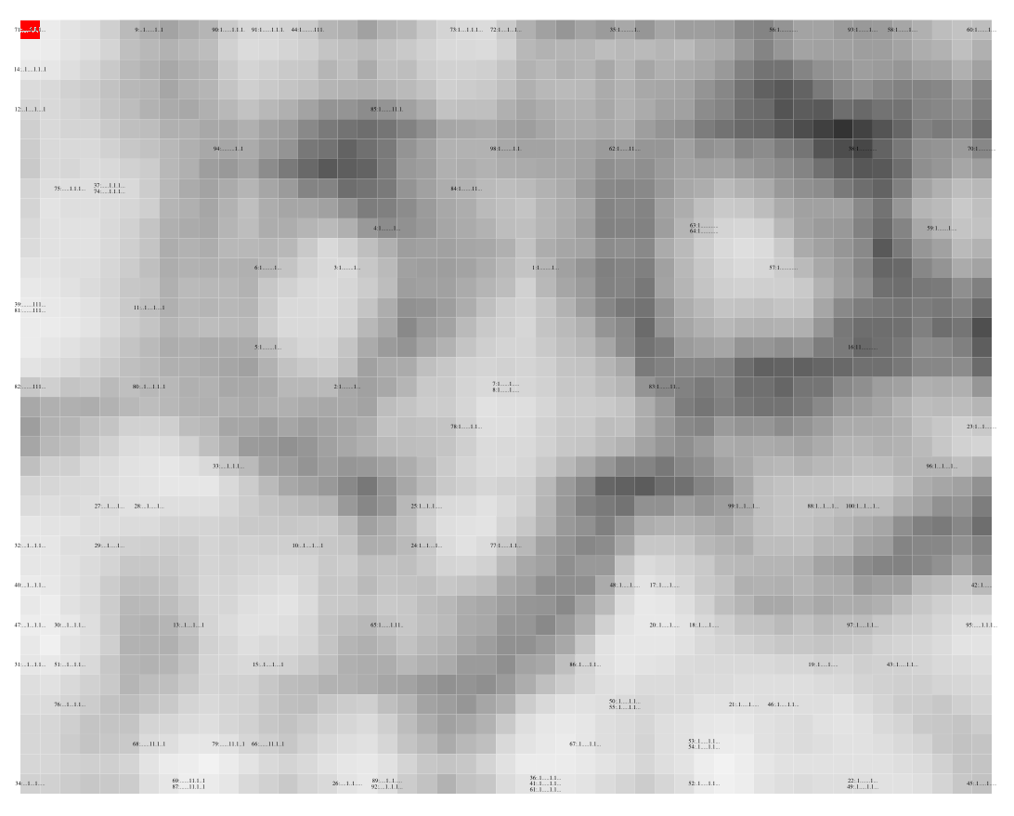
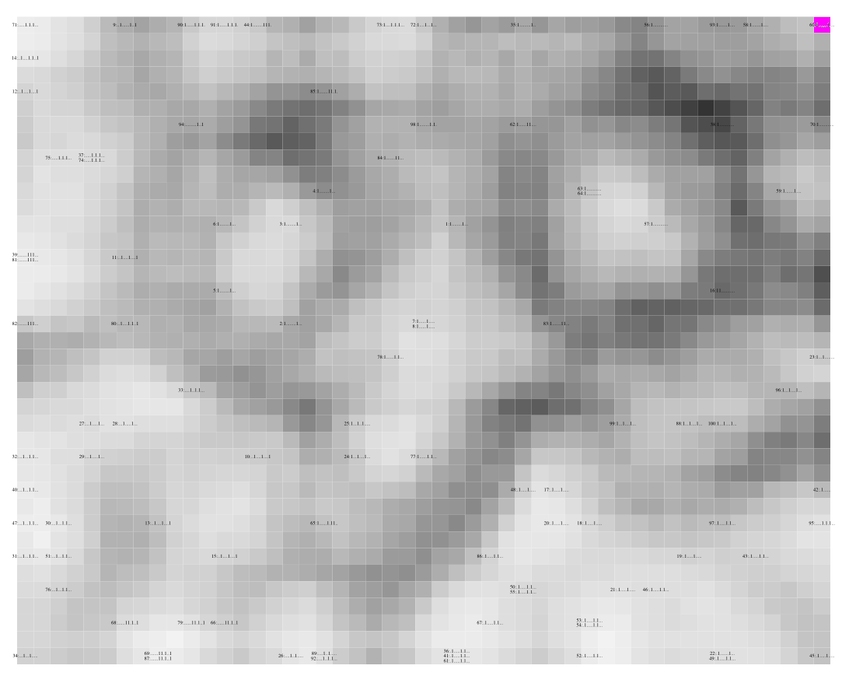
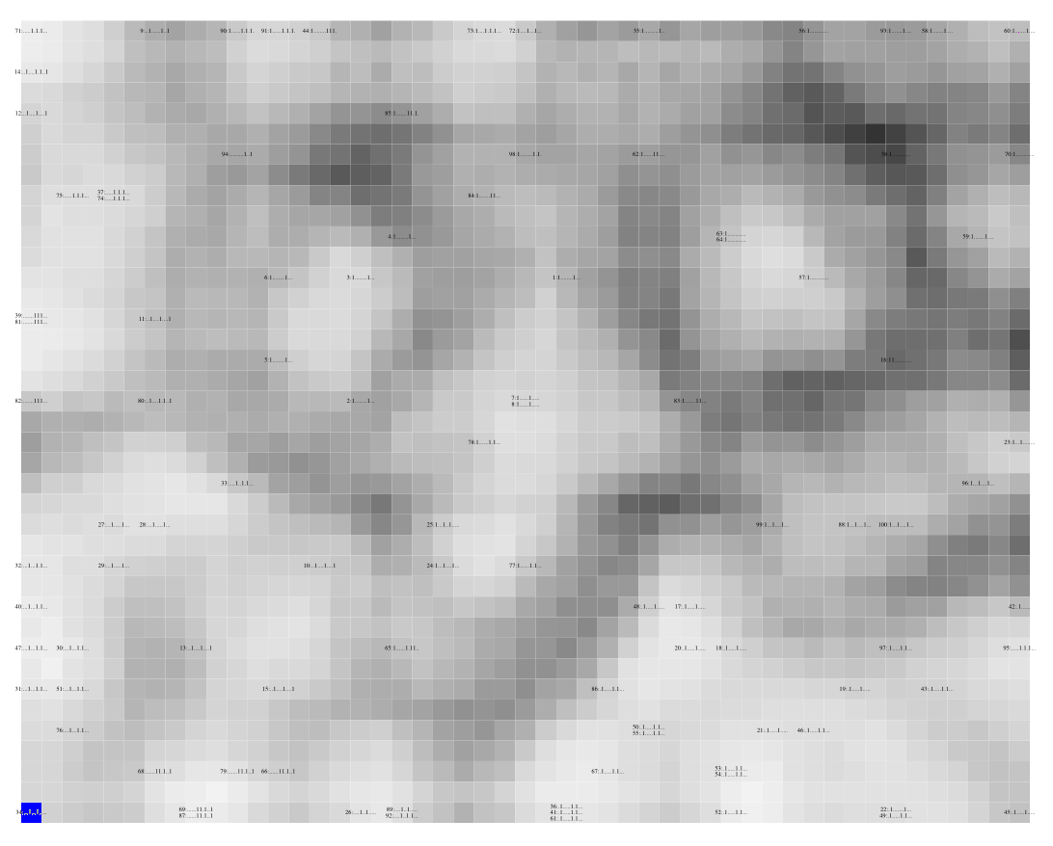
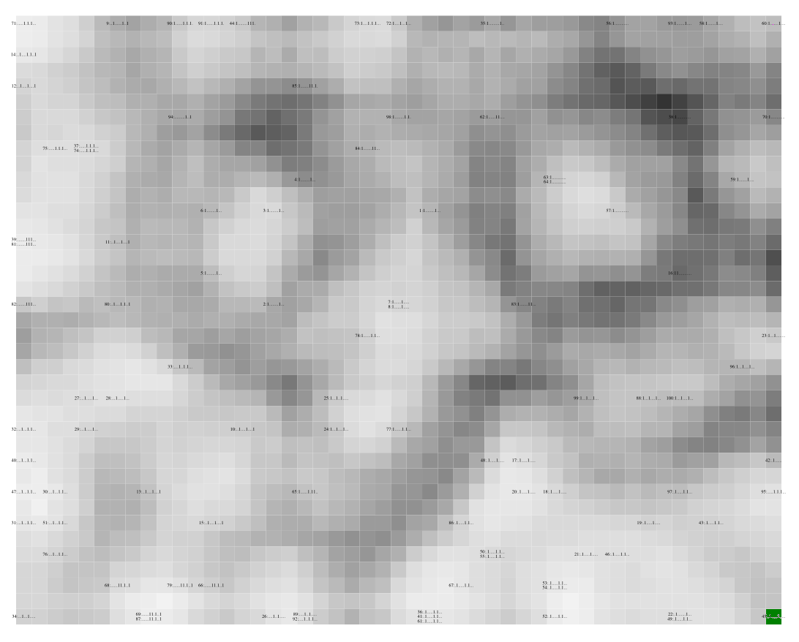
SOM Neurons
SOM neurons capture information about the input data – similar to the centroids in k-means.
7000
6000
5000
4000
Wavenumber, cm⁻¹

Slide 5
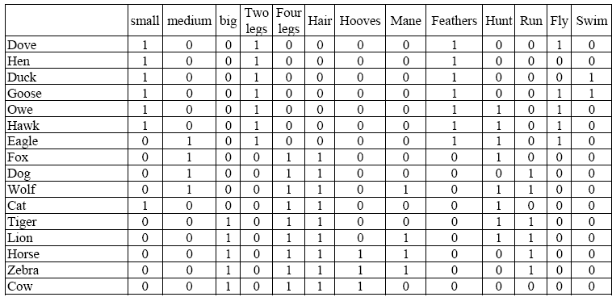
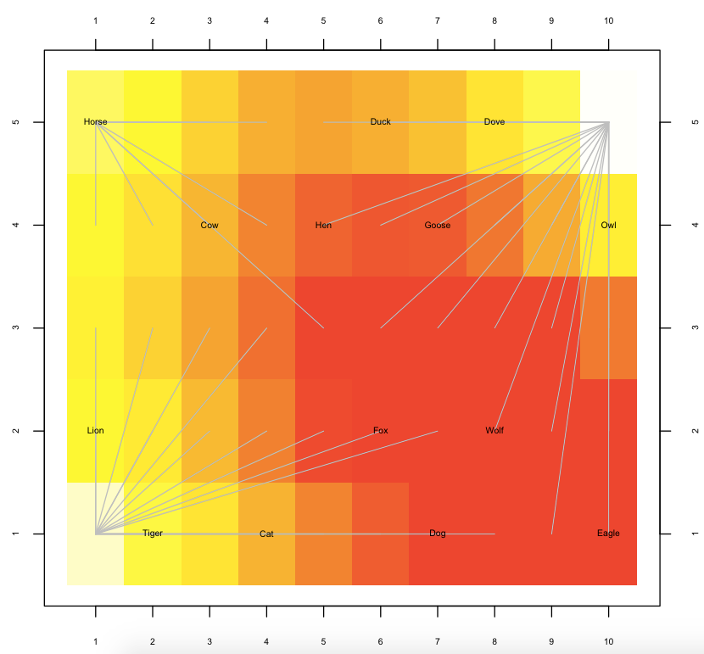
Training a SOM
“Grid of Neurons”
Visualization
Table of Feature Vectors
Algorithm:
Repeat until Done
For each row in Data Table Do
Find the neuron that best describes the row.
Make that neuron look more like the row.
Smooth the immediate neighborhood of that neuron.
End For
End Repeat

Slide 6
SOM Visualization
Bird Cluster
Ungulate Cluster
Hunter Cluster

Slide 7
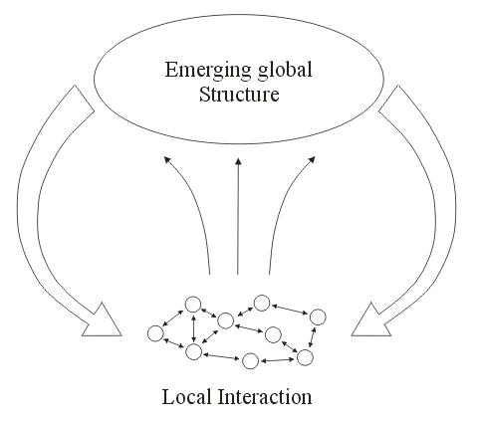
Self-Organization and Learning
Self-organization refers to a process in which the internal organization of a system increases automatically without being guided or managed by an outside source.
This process is due to local interaction with simple rules.
Local interaction gives rise to global structure.
We can interpret emerging global structures as learned structures.
Learned structures appear as clusters of similar objects.
Complexity : Life at the Edge of Chaos, Roger Lewin,
University Of Chicago Press; 2nd edition, 2000

Slide 8
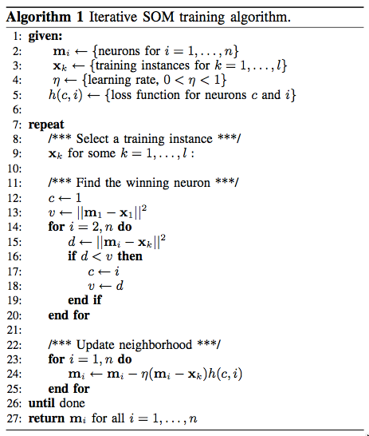
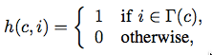
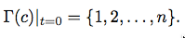
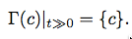
Iterative Training: SOM
The Loss Function:
The Neighborhood Function (time dependent):
Compare input to each neuron
update all neurons
This is the “standard” training algorithm for SOMs implemented in most packages.

Slide 9
Applications of SOM
Infrared Spectroscopy
Goal: to find out if compounds are chemically related without performing an expensive chemical analysis.
Each compound is tested for light absorbency in the infrared spectrum.
Specific chemical structures absorb specific ranges in the infrared spectrum.
This means, each compound has a specific “spectral signature”.
We can use SOMs to investigate similarity.

Slide 10
Training SOM with Spectra
Grid of Neurons
Spectral
Library
3000
2000
1000
Random Number Spectra

Slide 11
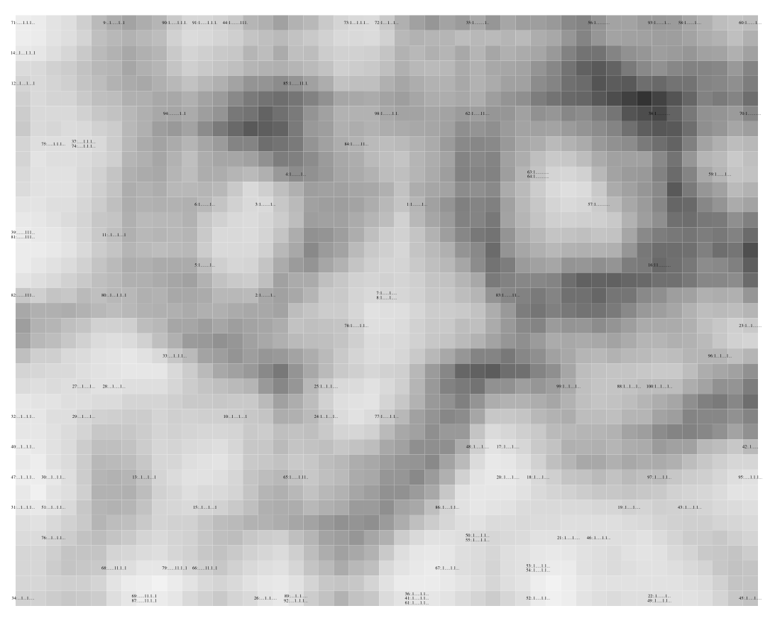
NIR SOM Functional Groups
Ester-N
Cl_{x}-N
Carbonyls
Poly-N
CH₃-N
Aromatics
C_{x}H_{y}-N
NH₂-N
Alkanes
Alcohols
Acids
Amines

Slide 12
NIR Centroid Spectra
7000
6000
5000
4000
Wavenumber, cm⁻¹

Slide 13
NIR Significance Spectrum
N
Significance
N-H
-OH
-CH₃
-CH₂-
7000
6000
5000
4000
Wavenumber, cm⁻¹

Slide 14
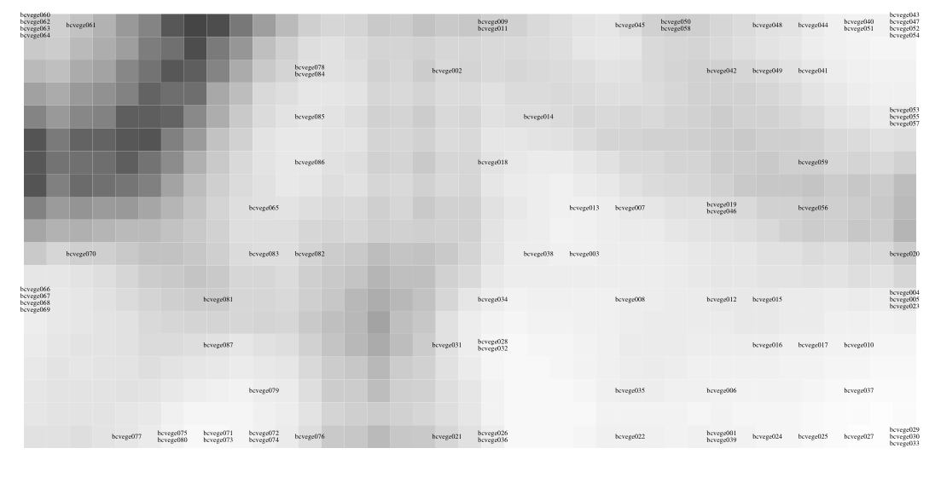
SOM Bacterium b-cereus on different agars “You are what you eat!”
Mannitol
Chocolate Blood
Nutrient
Blood
“You are what you eat!”

Slide 15
Significance Spectrum b-cereus on different agars
Significance
2000
1600
1200
800
Wavenumber, cm⁻¹

Slide 16
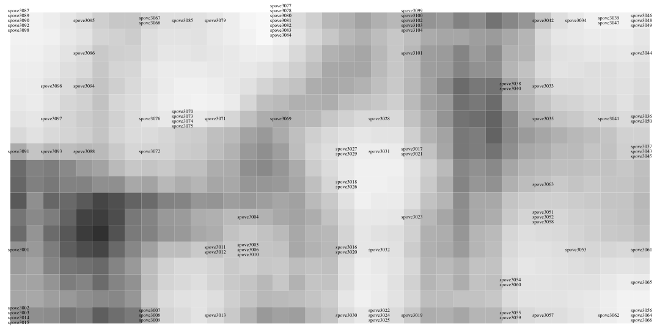
SOM Bacteria Spectra
b-thur
b-subtilis
b-cereus
b-subtilis
b-cereus
b-thur
b-anthracis
⬅spores / vegetative➔

Slide 17
Significance Spectrum vs b-subtilis 1st Derivative Spectra
Significance
2000
1600
1200
800
Wavenumber, cm⁻¹

Slide 18
Applications of SOM
Clustering Proteins based on the architecture of their activation loops.
Align the proteins under investigation.
Extract the functional centers.
Turn 3D representation into 1D feature vectors.
Cluster based on the feature vectors.
Joint work with Dr. Gongqin Sun, Dept. of Cell and Molecular Biology, URI

Slide 19
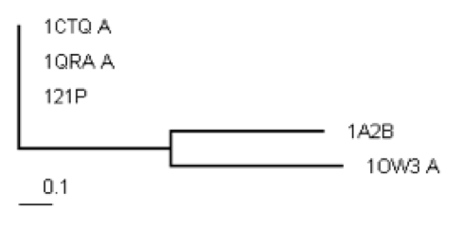
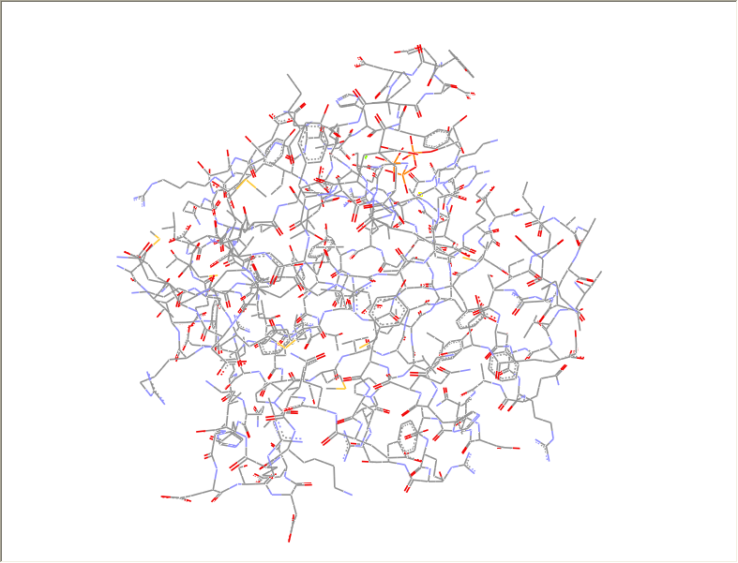
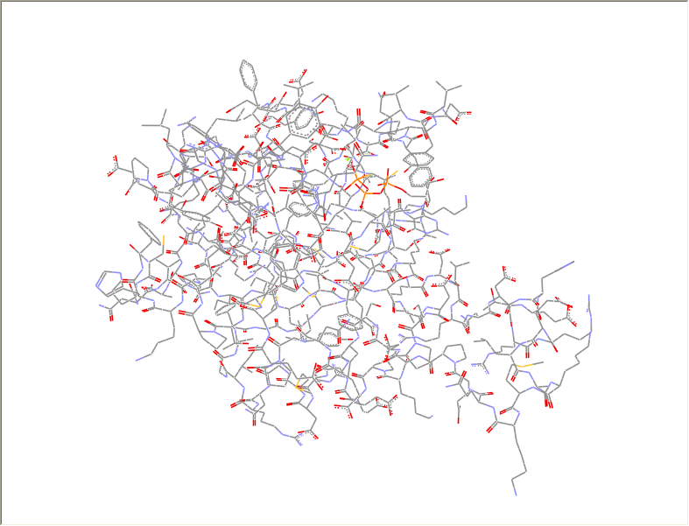
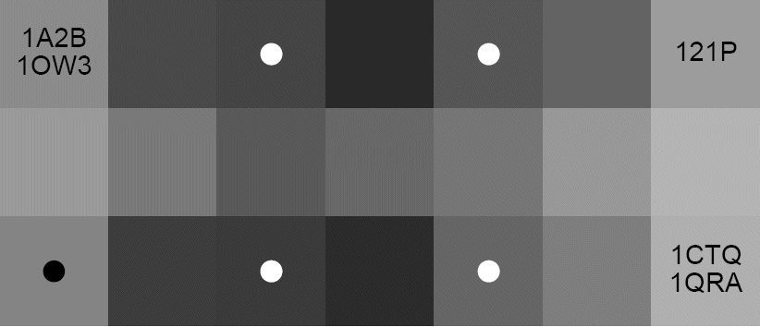
Structural Classification of GTPases
Can we structurally distinguish between the Ras and Rho subfamilies?
Ras: 121P, 1CTQ, and 1QRA
Rho: 1A2B and 1OW3
F = p-loop, r = 10Å
1CTQ
1A2B
Rho
Ras

Slide 20
Demo
popsom package in R
Very fast implementation
Statistically motivated convergence criterion

Slide 21
The End

